Slide 1
Place and Liveability
Year 7

Slide 2
Perception
Perception:
The way you think about or understand something.
It can contain bias.

Slide 3
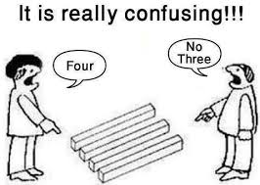
How many do you see?

Slide 4
Perception is influenced by:
Age
Income
Household type
Gender
Cultural background
Education
Note these influences.
Can you think of three more influences?

Slide 5
Contrast different perceptions:
Older people vs teenagers
People with children vs people without children
A disabled person and an able bodied person
What do you think these different groups believe makes a place liveable?
Choose 1 or 2 or 3
Discuss with a partner and share with the class.

Slide 6
Liveability Ratings
General categories to assess liveability:
Public safety
Housing affordability
Aesthetic (attractive)
Accessibility to transport
Recreational, educational & health facilities
Utilities (electricity, water, sewerage systems)
Environmental (climate, open space, air quality)
Telecommunications infrastructure

Slide 7
City vs country
City – What are the advantages?
Greater range of jobs
Access to a wide range of shops and services
Greater choice of schools
More entertainment options
Faster pace of life
Access to a wide range of medical facilities
Think of three disadvantages.

Slide 8
City vs country
Country – What are the advantages?
Space
Lack of crowds
Cleaner air and less pollution
Cheaper housing
More opportunities for outdoor activities
Think of three disadvantages.

Slide 9
City vs country
When you are an adult do you think you will live in a city or in the country?
Name a place you would like to live.
Why do you think so?
What is important to YOU for liveability?
Will your needs and perceptions change over time? Why? Why not?
Discuss these questions in a group.

Slide 10
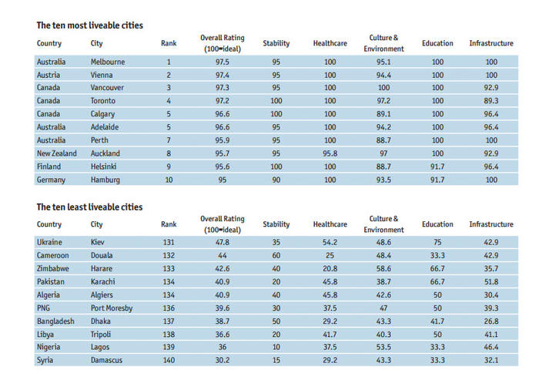
Most to least liveable cities 2017

Slide 11
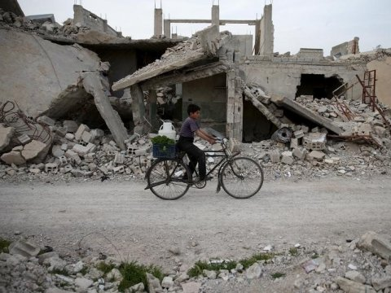
The Syrian capital of Damascus saw the second biggest decline in liveability, falling 16.1 points from 2016.
Damascus was the lowest-ranked city with a rating of just 30.2 out of 100, scoring poorly in all categories due to Syria’s civil war.
Kiev, the only European city in the bottom ten, performs better for health care and education but has a low stability score due to Ukraine’s ongoing conflict with Russia.

Slide 12


Safety and Crime
Liveability of a place declines if people fear death or damage to property.
The Terrorism Risk Index ranks Somalia followed by Pakistan as most at risk countries.
The Global Peace Index ranks Iceland, New Zealand and Denmark most peaceful.
What rank does Australia hold?
Peace
Millions of people live in dangerous countries where kidnapping, murder, disease, terrorism and theft affect well being.

Slide 13

Global Peace index
Australia ranks……………… # 25

Slide 14
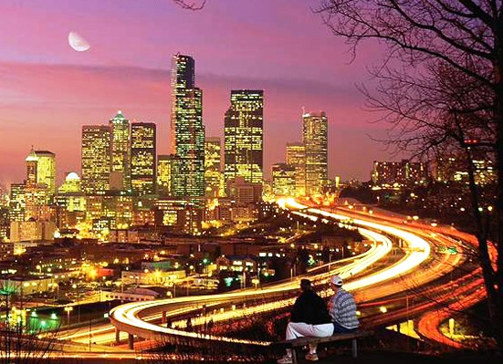
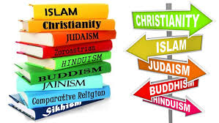
Large cities
People have lived in
cities for thousands of
years.
Cities develop around:
Trade
Defence
Religion
Culture
Political power
Why would early cities have been located on harbours and rivers?

Slide 15

positives and negatives
Positives:
Efficiency
Convenience
Concentration of resources (educational/medical)
Better social integration
Negatives:
Crowding
Lack of sanitation
Crime
Unemployment
Slums

Slide 16
Skyscrapers and Sprawl
Housing Density: is the number of dwellings in an area of land. High density housing includes apartments and skyscrapers. In developing countries, millions of people live in slums.
Sprawl: as cities grow, lower density housing spreads outwards from the CBD to surrounding farmland and natural environment.
In Australia, the government want to minimise urban sprawl.
FACTS!!
In Singapore 60% of people live in sky scrapers.
Mumbai, India houses 34,000 per square km.

Slide 17
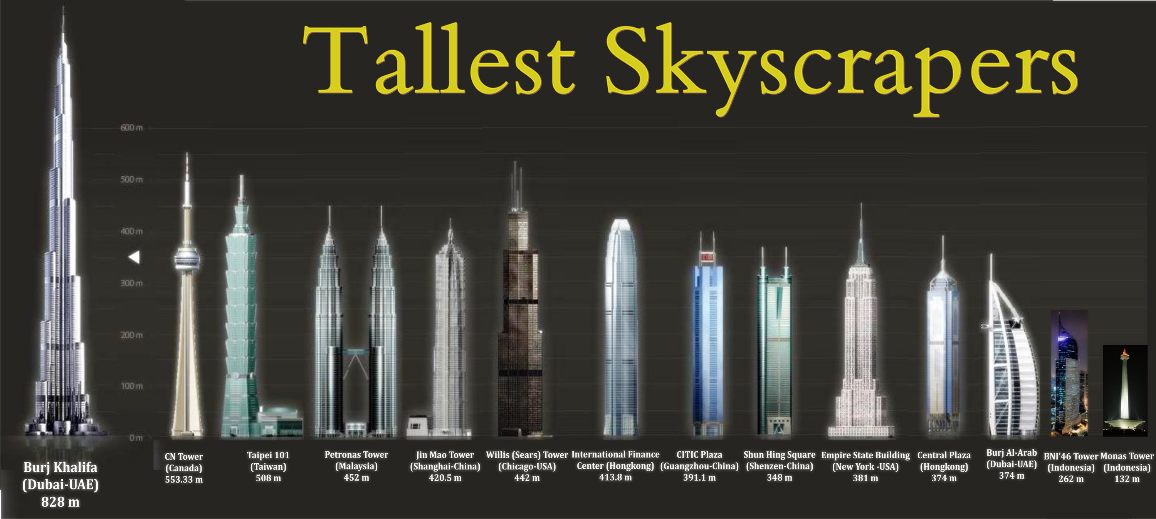
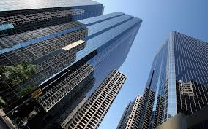
skyscrapers

Slide 18
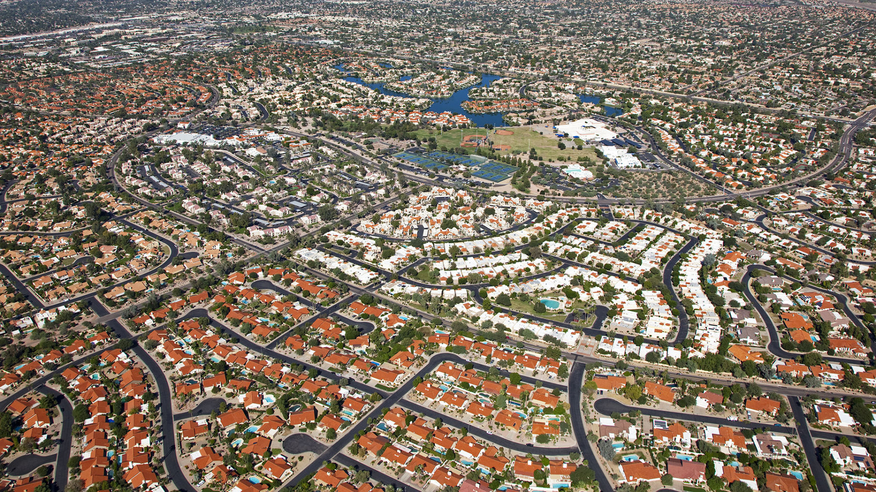
Urban sprawl

Slide 19
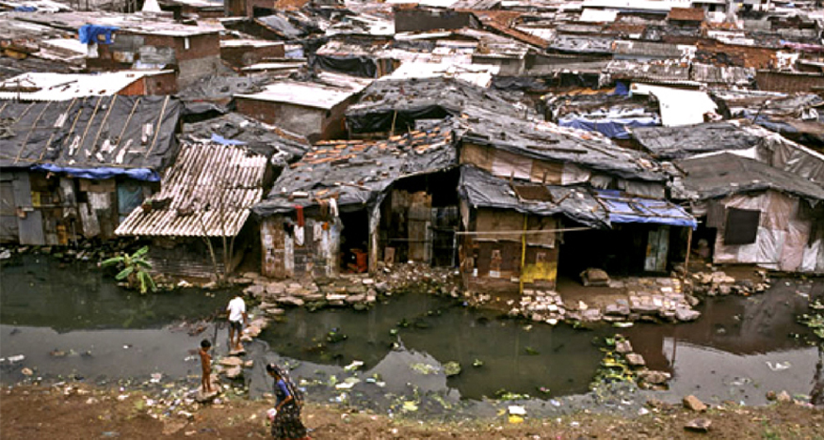
slums

Slide 20
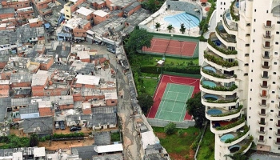
Slums and apartment building side by side

Slide 21
Megacities
Megacity: A megacity is defined by the United Nations as a metropolitan area with a total population of more than 10 million people.
By 2025, China, the world’s most populated country, will have eight megacities.

Slide 22
Urbanisation and megacities
https://www.youtube.com/watch?v=-ApGzilTwBU
Megacities are known as cities with more than __________ million people.
Where in the world are the majority of megacities?
What is the population of Jakarta today?
There is a great ____________ of wealth in Jakarta.
Describe two of the problems faced by Indonesian's living in Jakarta.
What things are World Vision doing to help improve the lives of Indonesians?

Slide 23
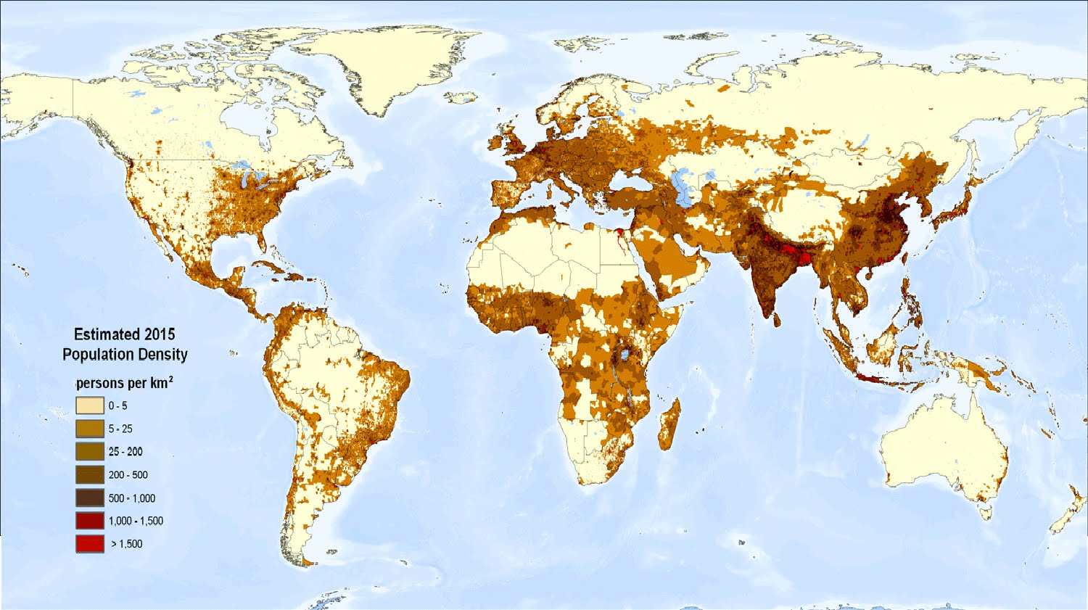
World population density map

